Slide 1
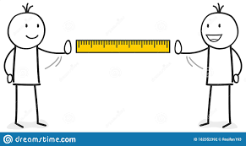
Minimum Edit Distance
Notes:
Lecture 4:
Minimum Edit Distance (MED)

Slide 2
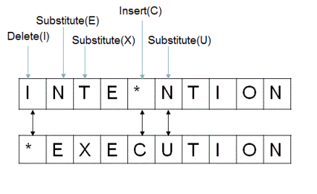
Definition of Minimum Edit Distance:
Edit distance between two strings s1 and s2 is the minimum number of basic operations that transform s1 into s2.
Notes:
What is Min Edit Distance?
The minimum edit distance (MED) measures the minimum number of single-character edits (insertions, deletions, substitutions) required to transform one string into another. Imagine you have two misspelled words and want to know the least number of changes needed to make them correct. MED helps quantify this difference.
In the provided diagram, the word "INTENTION" is being transformed into "EXECUTION" using the following operations:
Substitute (E): The letter “N" is replaced by "E".
Insert (C): The letter "C" is inserted after "E".
Delete (I): The letter "I" is deleted.
Substitute (X): The letter “T" is replaced by "X".
Substitute (U): The letter “N" is replaced by "U".

Slide 3
How similar are two strings?
Spell correction
The user typed “graﬀe” Which is closest?
graf
graft
grail
giraﬀe
Computational Biology
Align two sequences of nucleotides
AGGCTATCACCTGACCTCCAGGCCGATGCCC TAGCTATCACGACCGCGGTCGATTTGCCCGAC
Resulting alignment:
-AGGCTATCACCTGACCTCCAGGCCGA--TGCCC---
TAG-CTATCAC--GACCGC--GGTCGATTTGCCCGAC
Also for Machine Translation, Information Extraction, Speech Recognition
Notes:
Applications:
Computational Biology: MED helps compare biological sequences like DNA, RNA, and proteins, aiding researchers in understanding genetic similarities and differences.
Spell Checking: MED suggests corrections for misspelled words based on the closest match in a dictionary.
Machine Translation: MED measures the number of edits needed to align machine-translated text with the original, indicating translation accuracy.
Information Retrieval: MED helps find relevant documents or keywords in a database by ranking based on similarity to a query.
Plagiarism Detection: MED identifies potential instances of plagiarism by comparing submitted text with potential source material, flagging high similarity.

Slide 4

Edit Distance
The minimum edit distance between two strings
Is the minimum number of editing operations
Insertion
Deletion
Substitution
Needed to transform one into the other
Notes:
There are two main approaches to calculating MED:
Recursive Algorithm: Breaks down the problem into smaller subproblems, but can be inefficient for larger strings.
Dynamic Programming: Builds a table to store intermediate results, improving efficiency for longer strings.

Slide 5

Minimum Edit Distance
Two strings and their alignment:
Notes:
In the provided diagram, the word "INTENTION" is being transformed into "EXECUTION“.
MED focuses on minimum edits, not necessarily the most meaningful transformation.
Beyond Character-Level Similarity:
While MED is valuable, it only considers character-level similarity. For tasks requiring deeper understanding, other techniques like word embeddings and semantic similarity metrics are explored

Slide 6
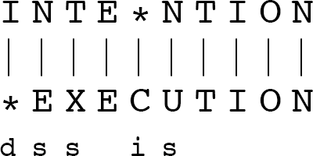
Minimum Edit Distance
If each operation has cost of 1
Distance between these is 5
If substitutions cost 2 (Levenshtein)
Distance between them is 8
Notes:
Distance is 5: This means it takes five single-character edits (insertions, deletions, substitutions) to transform "intention" into "execution" with equal costs for each type of edit.
With substitutions costing 2 (Levenshtein distance):
Distance is 8: This signifies that eight single-character edits are needed when substitutions have a higher penalty compared to insertions and deletions.
Substitute (E): The letter “N" is replaced by "E". ------ cost :2
Substitute (X): The letter “T" is replaced by "X". ------ cost: 2
Substitute (U): The letter “N" is replaced by "U". ------ cost: 2
The 3 substitutions and 2 other operations would totally cost distance of 8

Slide 7
Alignment in Computational Biology
Given a sequence of bases
AGGCTATCACCTGACCTCCAGGCCGATGCCC TAGCTATCACGACCGCGGTCGATTTGCCCGAC
An alignment:
-AGGCTATCACCTGACCTCCAGGCCGA--TGCCC--- TAG-CTATCAC--GACCGC--GGTCGATTTGCCCGAC
Given two sequences, align each letter to a letter or gap
Notes:
Sequence Alignment in Computational Biology
Alignment is a fundamental concept in computational biology, particularly when dealing with biological sequences like DNA, RNA, and proteins. It refers to the process of arranging these sequences in a way that highlights their similarities and differences. This allows researchers to:
Identify conserved regions.
Infer evolutionary relationships

Slide 8
Other uses of Edit Distance in NLP
Evaluating Machine Translation and speech recognition
R Spokesman confirms
H Spokesman said
S
senior government adviser was shot
adviser was shot dead
I
the senior
I D
Named Entity Extraction and Entity Coreference
IBM Inc. announced today
IBM profits
Stanford President John Hennessy announced yesterday
for Stanford University President John Hennessy
Notes:
Edit Distance in Machine Translation and Speech Recognition:
Machine Translation:
Evaluating Translation Quality: MED can be used to compare the original source text with the machine-translated text. The lower the edit distance, the closer the translated text is to the original and potentially the better the translation quality.
Speech Recognition:
Correcting Errors: MED can be used to compare the recognized speech with potential correct words in a vocabulary.

Slide 9
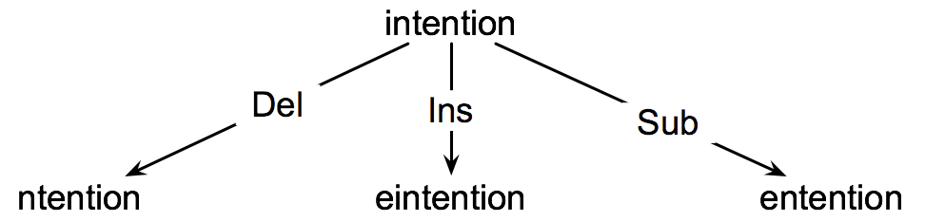
How to ﬁnd the Min Edit Distance?
Searching for a path (sequence of edits) from the start string to the final string:
Initial state: the word we’re transforming
Operators: insert, delete, substitute
Goal state: the word we’re trying to get to
Path cost: what we want to minimize: the number of edits
Notes:
searching for a path (sequence of edits) from the start string to the final string:
Problem Representation:
State Space: The set of all possible string states that can be reached through a sequence of edits (insert, delete, substitute) applied to the initial string.
Initial State: The starting string you want to transform, represented in the image as "intention".
Goal State: The target string you aim to reach, represented in the image as "execution".
Operators: The actions that can change the state of the string:
Insert: Adding a character at any position.
Delete: Removing a character from any position.
Substitute: Replacing a character with another character.
Path Cost: The total number of edits required to transform the string from the initial state to the goal state. The goal is to find a path with the minimum cost.

Slide 10
Minimum Edit as Search
But the space of all edit sequences is huge!
We can’t aﬀord to navigate naïvely
Lots of distinct paths wind up at the same state.
We don’t have to keep track of all of them
Just the shortest path to each of those revisted states.
Notes:
Addressing the Search Space Complexity:
Exploring all possible edit sequences can be computationally expensive and impractical for large string transformations.
The vast number of distinct paths can lead to redundant calculations and slow down the search process.
Optimizing the Search Strategy:
Instead of keeping track of all paths, we only need to focus on the shortest path that reaches each state.
This optimization helps us avoid unnecessary exploration and prioritize promising areas of the search space.

Slide 11
Deﬁning Min Edit Distance
For two strings
X of length n
Y of length m
We define D(i,j)
the edit distance between X[1..i] and Y[1..j]
i.e., the first i characters of X and the first j characters of Y
The edit distance between X and Y is thus D(n,m)
Notes:
Defining Minimum Edit Distance (MED) with D(i, j) Notation:
1. Minimum Edit Distance (MED):
It refers to the minimum number of single-character edits (insertions, deletions, substitutions) required to transform one string into another.
2. D(i, j) Notation:
This notation represents the edit distance between the first i characters of string X and the first j characters of string Y.
3. Relationship between D(i, j) and Overall MED:
The edit distance between the entire strings X and Y, denoted as D(n, m), can be calculated using the D(i, j) values: D(n, m) represents the minimum edit distance

Slide 12
Computing Minimum Edit Distance

Slide 13
Dynamic Programming for Minimum Edit Distance
Dynamic programming: A tabular computation of D(n,m)
Solving problems by combining solutions to subproblems.
Bottom-­‐up
We compute D(i,j) for small i,j
And compute larger D(i,j) based on previously computed smaller values
i.e., compute D(i,j) for all i (0 < i < n) and j (0 < j < m)
Notes:
Dynamic Programming Approach for Minimum Edit Distance:
Dynamic Programming:
It's a problem-solving technique that breaks down a complex problem into Bottom-Up Approach:
Dynamic programming often employs a bottom-up approach, starting with solving the simplest subproblems and gradually building up to the main problem.
Computing D(i, j):
The table is filled iteratively, starting from smaller values of i and j and progressing towards larger values.
To calculate D(i, j), we consider the following possibilities:
X[i] == Y[j]: No edit needed, D(i, j) = D(i-1, j-1).
X[i] != Y[j]: Three options arise:
Insertion: Insert Y[j] into X after X[i-1], D(i, j) = D(i-1, j) + 1.
Deletion: Delete X[i] from X, D(i, j) = D(i-1, j) + 1.
Substitution: Replace X[i] with Y[j], D(i, j) = D(i-1, j-1) + 1.
D(i, j) is then assigned the minimum value among these three options.

Slide 14
Deﬁning Min Edit Distance (Levenshtein)
Initialization D(i,0) = i D(0,j) = j
Recurrence Relation:
For each i = 1…M
For each j
D(i,j)=
= 1…N
D(i-1,j) + 1
min D(i,j-1) + 1
D(i-1,j-1) +
2; if X(i) ≠ Y(j)
0; if X(i) = Y(j)
Termination:
D(N,M) is distance
Notes:
Let me explain you step by step in each slide
Step 1: Initialization:
This step sets up the base conditions for the dynamic programming table (D). The table D is a matrix where D(i, j) represents the edit distance between the first i characters of one string and the first j characters of the other string.
D(i, 0) = i: This means that the distance between a string of length i and an empty string is i, because it would take i deletions to transform the string into an empty string.
D(0, j) = j: Similarly, the distance between an empty string and a string of length j is j, since it would take j insertions to transform the empty string into the other string.

Slide 15
The Edit Distance Table
N | 9
O | 8
I | 7
T | 6
N | 5
E | 4
T | 3
N | 2
I | 1
# | 0 | 1 | 2 | 3 | 4 | 5 | 6 | 7 | 8 | 9
 | # | E | X | E | C | U | T | I | O | N
Notes:
Step 1: Initialization:
This step sets up the base conditions for the dynamic programming table (D). The table D is a matrix where D(i, j) represents the edit distance between the first i characters of one string and the first j characters of the other string.
D(i, 0) = i: This means that the distance between a string of length i and an empty string is i, because it would take i deletions to transform the string into an empty string.
D(0, j) = j: Similarly, the distance between an empty string and a string of length j is j, since it would take j insertions to transform the empty string into the other string.

Slide 16
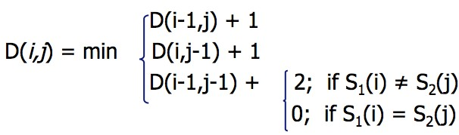
The Edit Distance Table
N | 9
O | 8
I | 7
T | 6
N | 5
E | 4
T | 3
N | 2
I | 1
# | 0 | 1 | 2 | 3 | 4 | 5 | 6 | 7 | 8 | 9
 | # | E | X | E | C | U | T | I | O | N
Notes:
Step 2: Recurrence Relation:
This part describes the rules for filling in the rest of the dynamic programming table based on the previous entries.
For each i = 1...M and each j = 1...N (where M and N are the lengths of the two strings being compared), the value of D(i, j) is the minimum of:
D(i-1, j) + 1: The edit distance of the string up to i-1 and the string up to j, plus one more operation for deleting the i-th character.
D(i, j-1) + 1: The edit distance of the string up to i and the string up to j-1, plus one more operation for inserting the j-th character of the second string.
D(i-1, j-1) + cost: The edit distance of the string up to i-1 and the string up to j-1, plus the cost of substituting the i-th character with the j-th character if they are different (cost = 2), or doing nothing if they are the same (cost = 0).

Slide 17
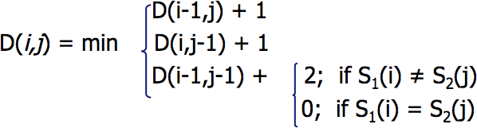
Edit Distance
N | 9
O | 8
I | 7
T | 6
N | 5
E | 4
T | 3
N | 2
I | 1
# | 0 | 1 | 2 | 3 | 4 | 5 | 6 | 7 | 8 | 9
 | # | E | X | E | C | U | T | I | O | N
Notes:
Step 2: Recurrence Relation:
This part describes the rules for filling in the rest of the dynamic programming table based on the previous entries.
For each i = 1...M and each j = 1...N (where M and N are the lengths of the two strings being compared), the value of D(i, j) is the minimum of:
D(i-1, j) + 1: The edit distance of the string up to i-1 and the string up to j, plus one more operation for deleting the i-th character.
D(i, j-1) + 1: The edit distance of the string up to i and the string up to j-1, plus one more operation for inserting the j-th character of the second string.
D(i-1, j-1) + cost: The edit distance of the string up to i-1 and the string up to j-1, plus the cost of substituting the i-th character with the j-th character if they are different (cost = 2), or doing nothing if they are the same (cost = 0).

Slide 18
The Edit Distance Table
N | 9 | 8 | 9 | 10 | 11 | 12 | 11 | 10 | 9 | 8
O | 8 | 7 | 8 | 9 | 10 | 11 | 10 | 9 | 8 | 9
I | 7 | 6 | 7 | 8 | 9 | 10 | 9 | 8 | 9 | 10
T | 6 | 5 | 6 | 7 | 8 | 9 | 8 | 9 | 10 | 11
N | 5 | 4 | 5 | 6 | 7 | 8 | 9 | 10 | 11 | 10
E | 4 | 3 | 4 | 5 | 6 | 7 | 8 | 9 | 10 | 9
T | 3 | 4 | 5 | 6 | 7 | 8 | 7 | 8 | 9 | 8
N | 2 | 3 | 4 | 5 | 6 | 7 | 8 | 7 | 8 | 7
I | 1 | 2 | 3 | 4 | 5 | 6 | 7 | 6 | 7 | 8
# | 0 | 1 | 2 | 3 | 4 | 5 | 6 | 7 | 8 | 9
 | # | E | X | E | C | U | T | I | O | N
Notes:
Step 3: Termination:
By taking the value D(N, M) as the edit distance between the two full strings.
This matrix approach allows for an efficient calculation of the edit distance using dynamic programming techniques, as it breaks down a complex problem into simpler subproblems. The final value D(N, M) gives the minimum number of insertions, deletions, and substitutions required to change one string into the other.

Slide 19
Backtrace for Computing Alignments

Slide 20
Computing alignments
Edit distance isn’t sufficient
We often need to align each character of the two strings to each other
We do this by keeping a “backtrace”
Every time we enter a cell, remember where we came from
When we reach the end,
Trace back the path from the upper right corner to read oﬀ the alignment
Notes:
The number of edits needed to transform one string into another, it doesn't explicitly tell us how those edits were performed or which characters correspond in the two strings. This is where alignment comes in.
Alignment with Backtracking:
Backtracking Table:
During the dynamic programming process, in addition to the minimum edit distance D(i, j) in each cell, we also store the direction from which the minimum cost was obtained. This is typically represented by symbols like "↑" (up), "←" (left), or "↖" (diagonal).

Slide 21
Edit Distance
N | 9
O | 8
I | 7
T | 6
N | 5
E | 4
T | 3
N | 2
I | 1
# | 0 | 1 | 2 | 3 | 4 | 5 | 6 | 7 | 8 | 9
 | # | E | X | E | C | U | T | I | O | N

Slide 22
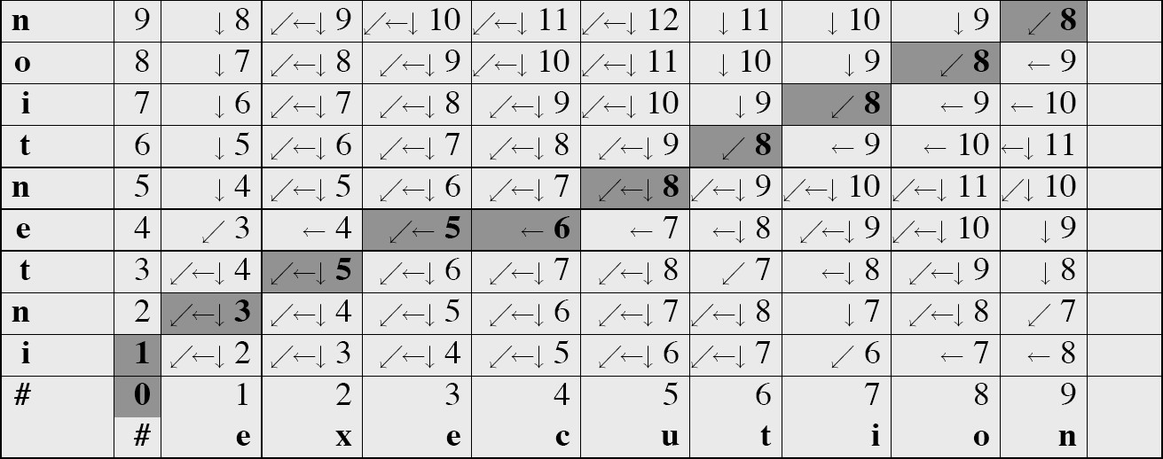
MinEdit with Backtrace
Notes:
2. Traceback Process:
Start from the bottom-right corner cell D(n, m).
Follow the backtracking pointers stored in each cell, moving in the opposite direction of the arrows.
1.If the direction is "↖" (diagonal), it indicates no edit (characters match). Add the corresponding characters from both strings to the alignment.
2. If the direction is "↑" (up), it indicates a deletion in the first string. Add a gap "-" to the first string's alignment and the corresponding character from the second string.
3.If the direction is "←" (left), it indicates an insertion in the second string. Add a gap "-" to the second string's alignment and the corresponding character from the first string.
3. Result:
By following the backtracking path, you'll obtain an alignment of the two strings, highlighting the corresponding characters and any insertions or deletions that occurred.

Slide 23
Adding Backtrace to Minimum Edit Distance
Base conditions:
D(i,0) = i
Recurrence Relation:
Termination:
D(N,M) is distance
D(0,j) = j
For each i = 1…M
For each j
= 1…N
D(i-1,j) + 1
min D(i,j-1) + 1
D(i-1, j-1)+
deletion
D(i,j)=
insertion
2; if X(i) ≠ Y(j)
0; if X(i) = Y(j)
substitution
ptr(i,j)=
LEFT DOWN DIAG
insertion
deletion
substitution
Notes:
Base Conditions:D(i, 0) = i and D(0, j) = j: Initializes the first row and column of the dynamic programming matrix, representing edit distances from the empty string to substrings of the input strings.
Recurrence Relation:For each cell D(i, j):
D(i-1, j) + 1: Represents deletion.
D(i, j-1) + 1: Represents insertion.
D(i-1, j-1) + 2: Represents substitution. Unlike standard Levenshtein distance, substitution costs 2 unless characters are the same (cost is 0).
Backtrace Pointers:ptr(i, j): Keeps track of chosen operation for each cell:
LEFT: Indicates insertion.
DOWN: Indicates deletion.
DIAG: Indicates substitution or no operation.
Termination:D(N, M) is the edit distance, the value in D corresponding to the full length of both strings (N and M)

Slide 24
The Distance Matrix
x₀ …………………… x_{N}
Every non-­‐decreasing path
from (0,0) to (M, N) corresponds to
an alignment
of the two sequences
An optimal alignment is composed of optimal subalignments
y₀ ……………………………… y_{M}
Notes:
A non-decreasing path from (0,0) to (M, N) in the context of a matrix refers to a path that starts at the top-left corner of the matrix and proceeds to the bottom-right corner without moving back up or to the left. Moves only right, down, or diagonally down-right.
An optimal alignment is one that minimizes the total cost or distance, which, in the case of sequences, could mean the fewest mutations required to convert one sequence into another.
The principle of optimal subalignments is a fundamental concept in dynamic programming, stating that the optimal alignment of two sequences contains within it the optimal alignment of any two subsequences.

Slide 25
Result of Backtrace
Two strings and their alignment:
Notes:
Minimum Edit Distance: 5
Table Initialization: Begins with 0s in the first row and column, representing the cost of inserting all characters from one string into the other.Iterative Filling: Cells are filled using the MED formula, considering insertions, deletions, and substitutions.Backtracking Arrows: Stored during filling process, indicating direction of minimum cost for each cell.Path Traversal: Starts from bottom-right corner (cell D(9, 9)).

Slide 26

Performance
Time:
O(nm)
Space:
O(nm)
Backtrace
O(n+m)
Notes:
Time Complexity:
Dynamic programming for calculating minimum edit distance between two strings has a time complexity of O(mn), where m and n are the lengths of the strings X and Y, respectively.
Space Complexity:
The algorithm requires space to store the DP table, which has dimensions (m+1) x (n+1).
This translates to a space complexity of O(mn) as well.
Backtracking:
Backtracking itself typically adds minimal additional space complexity compared to the DP table.
It stores pointers or symbols within the table cells to trace the path during backtracking.

Slide 27
Weighted Minimum Edit Distance

Slide 28
Weighted Edit Distance
Why would we add weights to the computation?
Spell Correction: some letters are more likely to be mistyped than others
Biology: certain kinds of deletions or insertions are more likely than others
Notes:
Adding weights to computations, especially in contexts like spell correction or biological sequence analysis, allows for a more nuanced and accurate model of real-world phenomena. By incorporating weights, these models can reflect the varying likelihood of different events, leading to more precise and meaningful interpretations or predictions

Slide 29
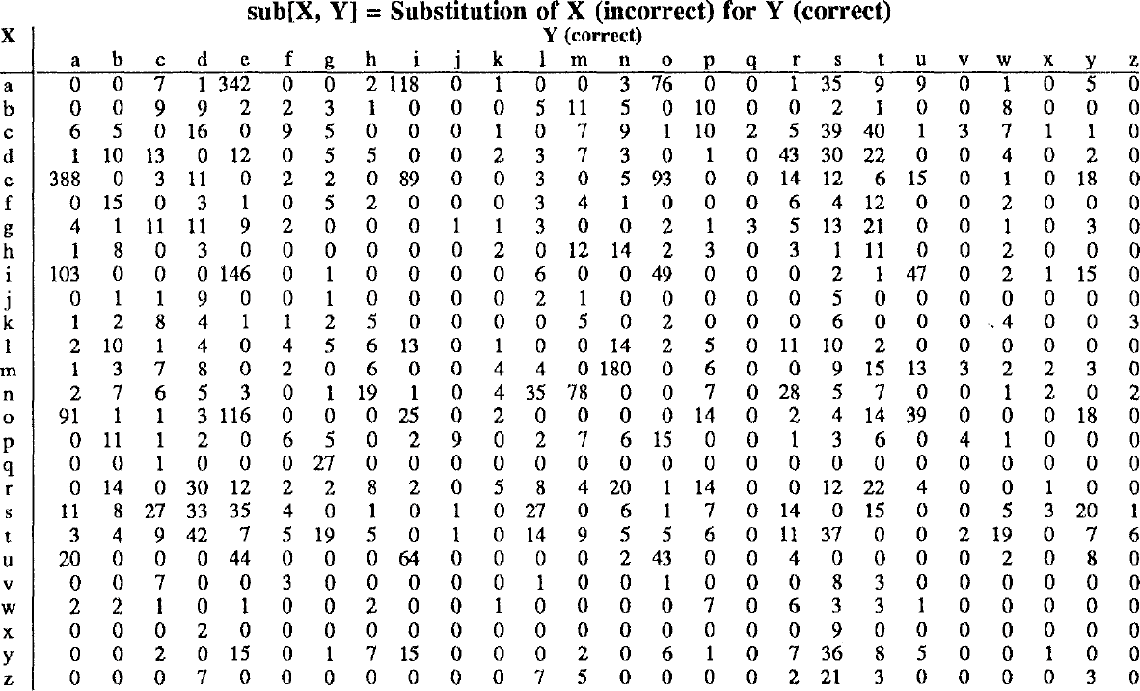
Confusion matrix for spelling errors
Notes:
Confusion Matrix for Spelling Errors (Substitution Errors):
Description: A table used to understand the frequency and types of substitution errors in text.
Rows (X axis): Represent mistyped characters.
Columns (Y axis): Represent correct characters.
Cells: Each cell shows the count or frequency of a specific substitution error where a mistyped character (X) was replaced with a correct character (Y).
Diagonal Cells: In traditional confusion matrices, diagonal cells represent correct predictions. However, in this context, they theoretically contain zeros since they represent correct spellings, not errors.

Slide 30
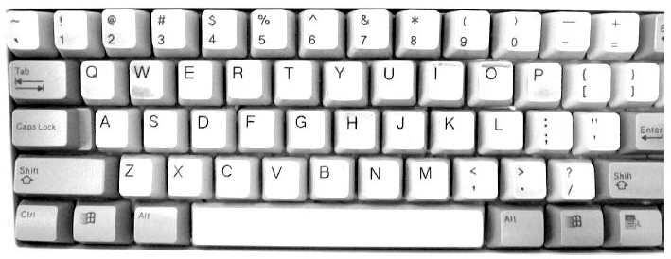
Notes:
Spell Correction
In spell correction algorithms, certain letters are more likely to be mistyped than others due to their physical proximity on a keyboard or frequent misuse in common language. For example, mistyping 'e' instead of 'w' is less common than mistyping 'e' instead of 'r' because 'e' and 'r' are adjacent on a standard QWERTY keyboard.

Slide 31
Weighted Min Edit Distance
Initialization:
D(0,0) | = | 0
D(i,0) | = | D(i-1,0) | + del[x(i)]; | 1 | < | i | ≤ | N
D(0,j) | = | D(0,j-1) | + ins[y(j)]; | 1 | < | j | ≤ | M
Recurrence Relation:
D(i-1,j)
+ del[x(i)]
+ ins[y(j)]
+ sub[x(i),y(j)]
D(i,j)= min
D(i,j-1)
D(i-1,j-1)
Termination:
D(N,M) is distance
Notes:
Description: Extension of Minimum Edit Distance algorithm, assigning different costs to insertion, deletion, and substitution operations.Initialization:D(0, 0) = 0: Distance between empty strings is zero.
D(i, 0) = Sum of deletion costs for characters in x.
D(0, j) = Sum of insertion costs for characters in y.
Recurrence Relation:Defines cost D(i, j) of transforming characters of x into characters of y as minimum of:
D(i-1, j) + deletion cost for x(i).
D(i, j-1) + insertion cost for y(j).
D(i-1, j-1) + substitution cost for x(i) and y(j).
Termination:D(N, M): Represents weighted minimum edit distance between full strings x and y.

Slide 32
Where did the name, dynamic programming, come from?
…The 1950s were not good years for mathematical research. [the] Secretary of Defense …had a pathological fear and hatred of the word, research…
I decided therefore to use the word, “programming”.
I wanted to get across the idea that this was dynamic, this was multistage… I thought, let’s … take a word that has an absolutely precise meaning, namely dynamic… it’s impossible to use the word, dynamic, in a pejorative sense. Try thinking of some combination that will possibly give it a pejorative meaning. It’s impossible.
Thus, I thought dynamic programming was a good name. It was something not even a Congressman could object to.”
Richard Bellman, “Eye of the Hurricane: an autobiography” 1984.

Slide 33
Minimum Edit Distance in Computational Biology

Slide 34
Sequence Alignment
AGGCTATCACCTGACCTCCAGGCCGATGCCC TAGCTATCACGACCGCGGTCGATTTGCCCGAC
-AGGCTATCACCTGACCTCCAGGCCGA--TGCCC--- TAG-CTATCAC--GACCGC--GGTCGATTTGCCCGAC
Notes:
Sequence Alignment example which is already explain in the beginning(refer to slide 7)

Slide 35
Why sequence alignment?
Comparing genes or regions from diﬀerent species
to find important regions
determine function
uncover evolutionary forces
Assembling fragments to sequence DNA
Compare individuals to looking for mutations
Notes:
Comparing genes or regions from different species:
Purpose: Identify conserved regions across species. Conserved regions are likely to be functionally important, as they have been preserved through evolution. Determining function:- Assigning a biological function to a gene or genomic region. Uncovering evolutionary forces:-Understanding the factors that have shaped the evolution of genes and genomes. Assembling fragments to sequence DNA: Reconstructing the complete sequence of a genome from short fragments of DNA. Comparing individuals to looking for mutations: Identifying genetic variations between individuals, which can be associated with disease, traits, or other phenotypes.

Slide 36
Alignments in two ﬁelds
In Natural Language Processing
We generally talk about distance (minimized)
And weights
In Computational Biology
We generally talk about similarity (maximized)
And scores
Notes:
Distance Metrics: Commonly used in tasks like word embedding, document retrieval, and machine translation. Includes Euclidean distance and cosine similarity. Similarity and Scores: Important in tasks like sentiment analysis, topic modeling, and text summarization. Involves maximizing similarity or scores based on specific criteria. Computational Biology: Similarity and Scores: Crucial for tasks like homology search, functional annotation, and evolutionary analysis. Includes techniques such as sequence alignment and protein structure comparison. Distance and Minimization: Used in tasks like identifying mutations or disease-associated variants. Involves minimizing the difference between observed sequences or gene expression patterns.

Slide 37
The Needleman-­‐Wunsch Algorithm
Initialization: D(i,0) = -i * d D(0,j) = -j * d
Recurrence Relation:
D(i-1,j)
D(i,j-1)
D(i-1,j-1)
d
d
+ s[x(i),y(j)]
D(i,j)= min
Termination:
D(N,M) is distance
Notes:
Needleman-Wunsch Algorithm:
Initialization: Matrix D initialized with gap penalties. First row and column filled with increasing gap penalties. Penalty d for introducing a gap in the alignment.
Recurrence Relation: Fill matrix using recurrence relation. Consider cost of aligning characters or introducing a gap. Options include aligning sequences or introducing gaps in either sequence. Score s(x[i], y[j]) determines alignment cost based on character matches or mismatches.
Termination: Final step finds optimal alignment score in cell D(N, M). N and M are lengths of sequences being aligned. Score in D(N, M) represents highest possible alignment score under given scoring system.

Slide 38
The Needleman-­‐Wunsch Matrix
x₁ ……………………………… x_{M}
(Note that the origin is at the upper left.)
y₁ …………………… y_{N}
Notes:
Purpose: Used in bioinformatics to align protein or nucleotide sequences.
Algorithm: Dynamic programming approach to find optimal alignment.
Calculation: Considers all possible alignments and assigns a score to each.
Best Alignment: Alignment with highest score is considered the optimal alignment.
Filling Process: Matrix filled with scores representing best alignment between prefixes of two sequences.
Scoring Scheme: Takes into account character matches or mismatches, as well as penalties for introducing gaps in sequences.

Slide 39
A variant of the basic algorithm:
Maybe it is OK to have an unlimited # of gaps in the beginning and end:
----------CTATCACCTGACCTCCAGGCCGATGCCCCTTCCGGC GCGAGTTCATCTATCAC--GACCGC--GGTCG--------------
If so, we don’t want to penalize gaps at the ends
Notes:
In some alignment scenarios, gaps introduced at the beginning or end of a sequence may not be biologically relevant due to:
Partial Alignments: The sequences being aligned are only fragments of larger sequences, and the regions outside the alignment are not of interest.
Sequence Trimming: The sequences have already been trimmed, and additional gaps at the ends do not provide further biological insights.
Evolutionary Considerations: Indels at sequence ends may be expected due to biological processes like recombination or the presence of non-coding regions. Domain-Specific Sequences: Alignment focus is on specific domains within proteins or other regions of interest, rather than the flanking regions.

Slide 40
Diﬀerent types of overlaps
Example:
2 overlapping“reads” from a sequencing project
Example:
Search for a mouse gene within a human chromosome
Notes:
Overlapping "Reads" from a Sequencing Project:
Process: Long DNA molecule broken into small fragments called "reads" for sequencing. Overlap: Sequencing reads may overlap when covering the same DNA region. Importance: Overlaps crucial for genome assembly to reconstruct full sequence. Goal: Use overlaps to piece together entire DNA sequence.
Search for a Mouse Gene within a Human Chromosome:
Scenario: Example of comparative genomics comparing sequences from different organisms. Task: Identify gene in mouse genome corresponding to known gene in human chromosome. Purpose: Study gene conservation across species to understand gene function and evolution. Indication: Image likely shows longer sequence with shorter one overlapping at certain regions, suggesting homology.

Slide 41
The Overlap Detection variant
Changes:
x₁ ……………………………… x_{M}
y₁ …………………… y_{N}
Initialization
For all i, j, F(i, 0) = 0
F(0, j) = 0
Termination
max_{i} F(i, N)
^{F}OPT
= max
max_{j} F(M, j)
Notes:
Variant of sequence alignment algorithm tailored for identifying best overlap between two sequences.Sequences:X1 ... Xm: Represents Sequence X of length m.
Y1 ... Yn: Represents Sequence Y of length n.
Grid: Scoring matrix used in dynamic programming for sequence alignment. Each cell reflects score aligning substring of X with substring of Y.
Path: Blue path shows chosen alignment path of algorithm. Starts at one sequence end and ends at optimal overlap position. Optimal overlap position may not be at other sequence end.

Slide 42
The Local Alignment Problem
x = x₁……x_{M}, y = y₁……y_{N}
Given two strings
Find substrings x’, y’ whose similarity (optimal global alignment value) is maximum
x = aaaacccccggggtta
y = ttcccgggaaccaacc
Notes:
Given strings X and Y of lengths M and N respectively and goal: Find substrings x' from X and y' from Y maximizing their similarity measured by alignment scoring.
Optimal Substring Alignment:
Aligned substrings x' and y' represent locally conserved sequences with highest alignment score.
Allows for more biologically relevant comparisons like identifying functional domains or motifs.
Alignment Matrix and Traceback:
Grid represents alignment matrix for local alignment scores via dynamic programming.
Path visualizes traceback step of local alignment algorithm (e.g., Smith-Waterman).
Starts from highest scoring cell and continues until encountering a cell with score 0, indicating start of high-scoring local alignment.

Slide 43
The Smith-­‐Waterman algorithm
Idea: Ignore badly aligning regions
Modifications to Needleman-­‐Wunsch:
Initialization:
F(0, j) = 0
F(i, 0) = 0
0
F(i – 1,
F(i, j –
F(i – 1,
Iteration:
F(i, j) = max
– d
– d
j – 1) + s(x_{i}, y_{j})
Notes:
Smith Waterman algorithm:
Initialization:
F(0, j) = 0 and F(i, 0) = 0: The scoring matrix F is initialized with zeros along the first row and first column. This differs from global alignment where the first row and column are initialized with gap penalties.
Iteration:
The scoring matrix F is filled using the following recurrence relation: F(i, j) = max(0, F(i-1, j) - d, F(i, j-1) - d, F(i-1, j-1) + s(xi, yj))
Four possibilities considered for each cell: Score of 0, allowing alignment to end at position without penalty (enables local alignment).
Score above minus gap penalty d, representing deletion.
Score to left minus gap penalty d, representing insertion.
Score diagonally up and left plus match/mismatch score s(xi, yj), representing match or mismatch.

Slide 44
The Smith-­‐Waterman algorithm
Termination:
1. If we want the best local alignment…
F_{OPT} = max_{i,j} F(i, j) Find F_{OPT} and trace back
2. If we want all local alignments scoring > t
?? For all i, j find F(i, j) > t, and trace back? Complicated by overlapping local alignments
Notes:
Termination:
Optimal local alignment score not necessarily at last cell F(i,j); maximum score in entire matrix taken as result.
Step 1: Finding the Best Local Alignment
Objective: Identify highest-scoring local alignment between two sequences.
Process: Search for cell with maximum score (F_OPT), representing end of best local alignment. Trace back from F_OPT through scoring matrix until reaching cell with score of zero, signifying start of aligned region.
Step 2: Finding All Local Alignments Scoring Above a Threshold (t)
Objective: Identify all alignments with score greater than specified threshold.
Process: Scan the entire scoring matrix and initiate a traceback from every cell whose score is above the threshold t. This will generate multiple local alignments that are above the threshold.

Slide 45
Local alignment example
 |  | A | T | T | A | T | C
 | 0 | 0 | 0 | 0 | 0 | 0 | 0
A | 0
T | 0
C | 0
A | 0
T | 0
X = ATCAT Y = ATTATC
Let:
m = 1 (1 point for match)
d = 1 (-­‐1 point for del/ins/sub)
Notes:
local alignment problem, likely to be solved using the Smith-Waterman algorithm. It provides two sequences, X and Y, and the beginnings of a scoring matrix that will be used for the alignment.
Sequences to be Aligned:
Sequence X: ATCAT
Sequence Y: ATTATC
Scoring Scheme:
m = 1: This indicates that when two letters (nucleotides) match, the score increases by 1 point.
d = 1: This denotes the penalty for a mismatch, insertion, or deletion (collectively called indels), which decreases the score by 1 point.

Slide 46
Local alignment example
 |  | A | T | T | A | T | C
 | 0 | 0 | 0 | 0 | 0 | 0 | 0
A | 0 | 1 | 0 | 0 | 1 | 0 | 0
T | 0 | 0 | 2 | 1 | 0 | 2 | 0
C | 0 | 0 | 1 | 1 | 0 | 1 | 3
A | 0 | 1 | 0 | 0 | 2 | 1 | 2
T | 0 | 0 | 2 | 0 | 1 | 3 | 2
X = ATCAT Y = ATTATC
Notes:
First row and column initialized to 0.
Filling the Matrix:
Each cell F(i, j) represents score of aligning substring of X ending at i and substring of Y ending at j.
Score for each cell is maximum of:
0 (end of alignment),
F(i-1, j-1) + 1 if X[i] matches Y[j],
F(i-1, j) - 1 if there's a gap in Y (deletion in X),
F(i, j-1) - 1 if there's a gap in X (insertion in Y).
Negative results set to 0 for local alignment scores.

Slide 47
Local alignment example
 |  | A | T | T | A | T | C
 | 0 | 0 | 0 | 0 | 0 | 0 | 0
A | 0 | 1 | 0 | 0 | 1 | 0 | 0
T | 0 | 0 | 2 | 1 | 0 | 2 | 0
C | 0 | 0 | 1 | 1 | 0 | 1 | 3
A | 0 | 1 | 0 | 0 | 2 | 1 | 2
T | 0 | 0 | 2 | 0 | 1 | 3 | 2
X = ATCAT
Y = ATTATC
Notes:
Cell [1,1]:
X = A, Y = A → Match.
Add 1 to diagonal cell [0,0] (0).
Cell [1,1] = 1.
Cell [2,2]:
X = T, Y = T → Match.
Add 1 to diagonal cell [1,1] (1).
Cell [2,2] = 2.
Cell [4,3]:
Mismatch: X ≠ Y.
Top-left diagonal ([3,2]) = 2.
Subtract 1 (for mismatch).
Cell [4,3] = 1.
Cell [5,4]:
Match: X = Y.
Top-left diagonal ([4,3]) = 1.
Add 1 (for match).
Cell [5,4] = 2.
Cell [5,5]:
Match and highest score in matrix.
Top-left diagonal ([4,4]) = 2.
Add 1 (for match).
Cell [5,5] = 3.

Slide 48
Local alignment example
X = ATCAT Y = ATTATC
 |  | A | T | T | A | T | C
 | 0 | 0 | 0 | 0 | 0 | 0 | 0
A | 0 | 1 | 0 | 0 | 1 | 0 | 0
T | 0 | 0 | 2 | 1 | 0 | 2 | 0
C | 0 | 0 | 1 | 1 | 0 | 1 | 3
A | 0 | 1 | 0 | 0 | 2 | 1 | 2
T | 0 | 0 | 2 | 0 | 1 | 3 | 2
Notes:
Traceback for Best Local Alignment:
Start from highest score in matrix: cell [5,5] with score 3.
Move diagonally for matches (adding 1) and up/left for gaps (subtracting 1).
Stop traceback when hitting cell with score of 0.
Traceback: cells [5,5], [4,4], [3,3], and [2,2].
Corresponds to local alignment of ATC in X with ATC in Y.
Red Numbers in Matrix:
Indicate cells involved in best local alignment based on traceback path.
Demonstrates how two sequences can be aligned to find most similar region within them, ignoring less similar regions.

